Slide 1

Markowitz Mean Variance Portfolio Selection DSA 5303
Ramkishore Rao

Slide 2
Presentation Outline
Study Scope
Solution Approach
Theoretical Framework
Input Stock Data
Analysis and Results
Conclusions

Slide 3
STUDY SCOPE
Stock Data from Publicly Held Companies
Small Cap
Mid Cap
Large Cap
Application of R Studio Packages
Theoretical Framework of Markowitz’s Mean Variance Model
Analysis and Results
Efficient Frontier
Portfolio Weights
Portfolio Return and Covariance
Dashboard Development
Conclusions

Slide 4
SOLUTION APPROACH
Quant Mod Package
Stock Data
Time Series Package
Conversion of Data Frame to Time Series Object
fPortfolio Package
Portfolio Analysis
Shiny Package
Dashboard Development

Slide 5
THEORETICAL FRAMEWORK
Markowitz’s Mean Variance Model , circa 1952
Efficient Frontier – Locus of Minimum Variance Points Above Minimum Variance Point
Covariance Used as Target Risk and Not VaR and CVaR.

Slide 6
INPUT STOCK DATA
Quant Mod Used
Stocks Traded on NYSE
Small Cap
Under a Billion to ~10 Billion
Mid Cap
<50 Billion
Large Cap
Up to and Over 1 Trillion

Slide 7
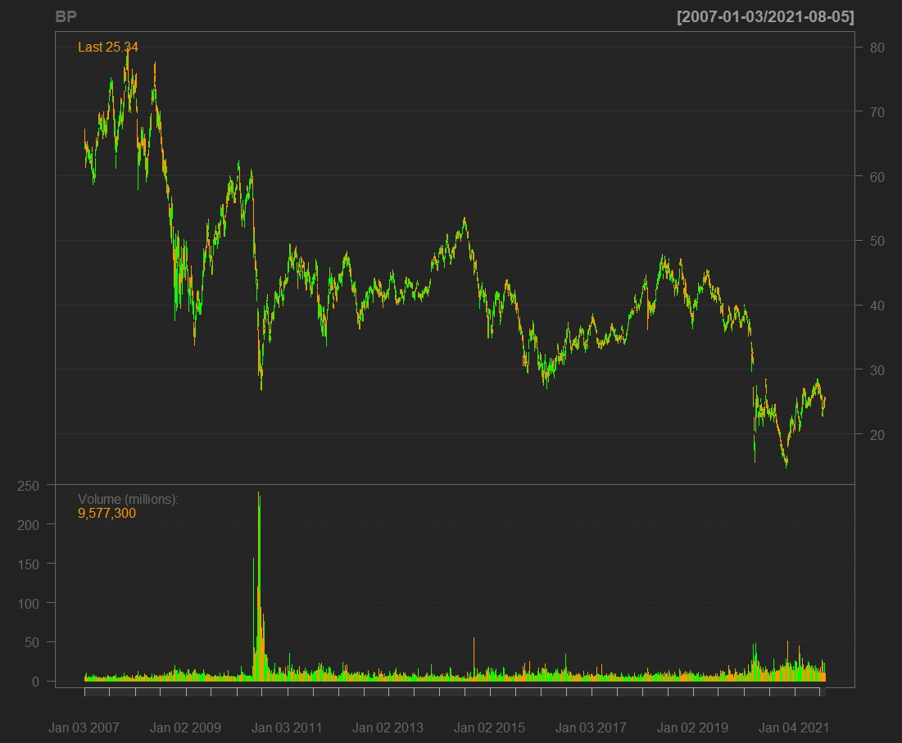
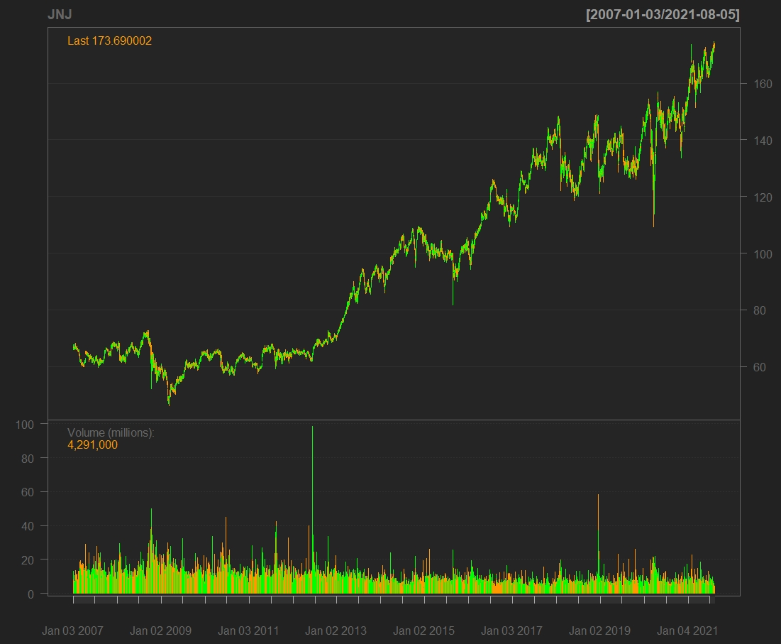
INPUT STOCK DATA
ANNUAL RETURN RATES, LARGE CAP
Stock Price Fluctuations – Bar Charts
Stocks – Volume Traded
Periodic Returns
Annual Rate of Returns Calculated

Slide 8
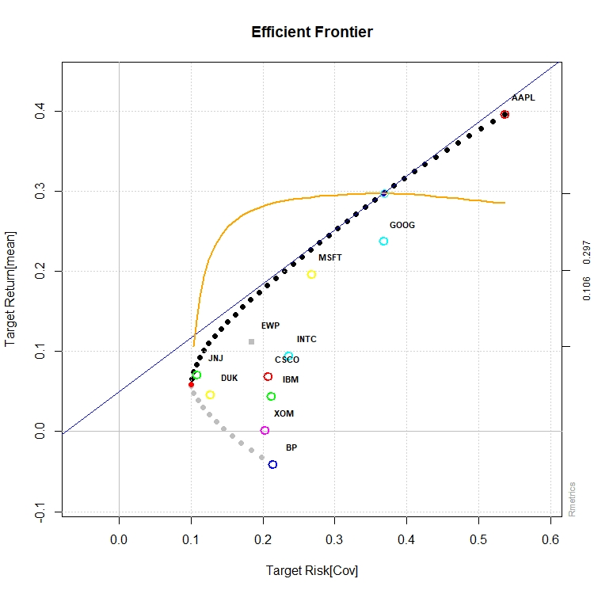
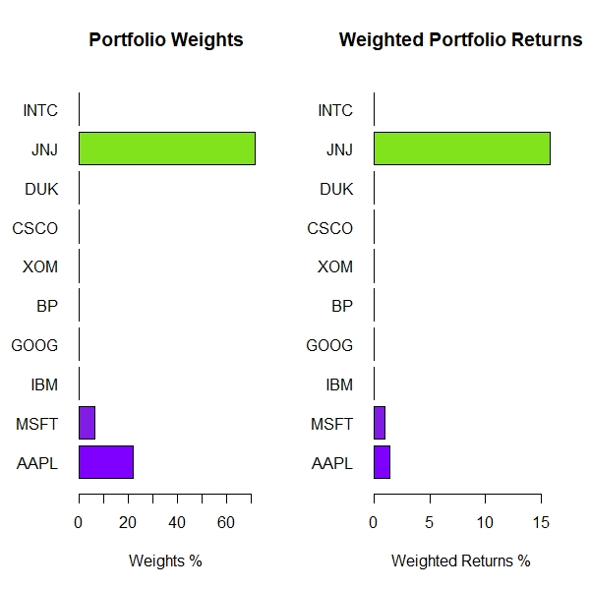
ANALYSIS AND RESULTS LARGE CAP
10 Stock Collection Analyzed
Long Only Strategy Evaluated
Desired Return 15 pct
Covariance(Risk) Determined for Target Return
Portfolio Weights Determined
RESULTS
JNJ, MSFT, AAPL Best Performing

Slide 9
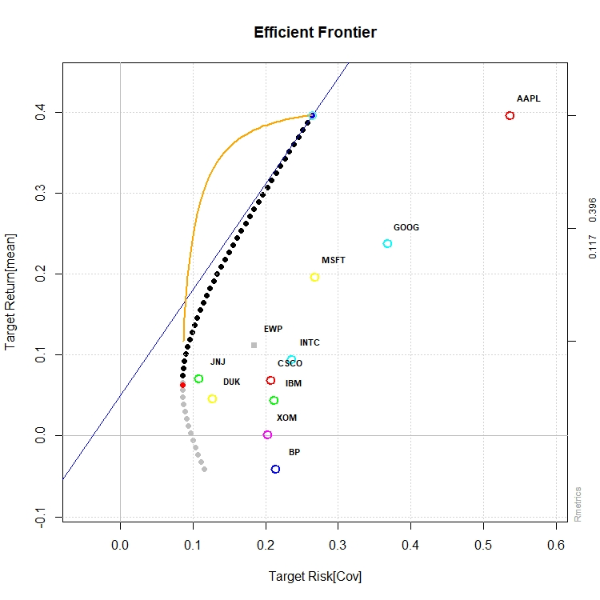
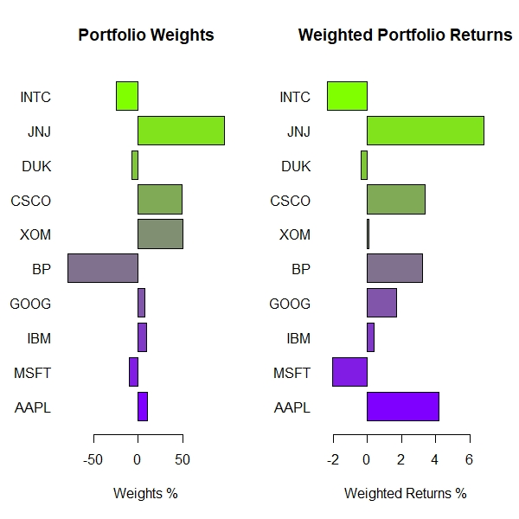
ANALYSIS AND RESULTS LARGE CAP
10 Stock Collection Analyzed
Long/Short Strategy
Desired Return 15 pct
Covariance(Risk) Determined for Target Return
Portfolio Weights Determined
RESULTS
Long Primarily on JNJ, CSCO, and XOM
Short Heavily on Underperforming Stock - BP

Slide 10
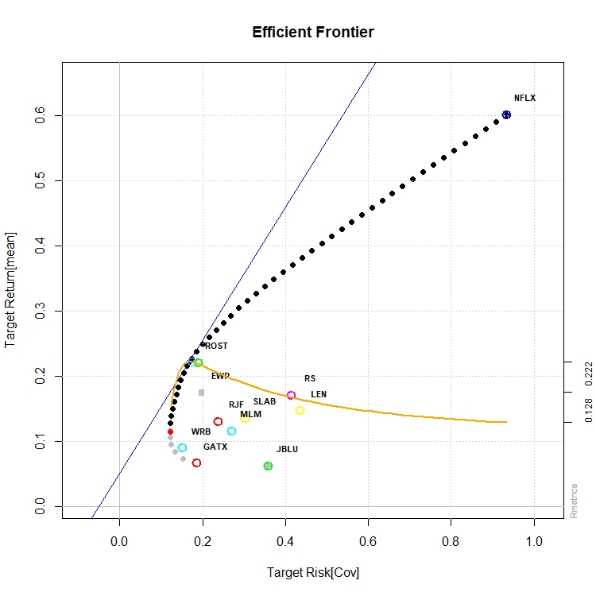
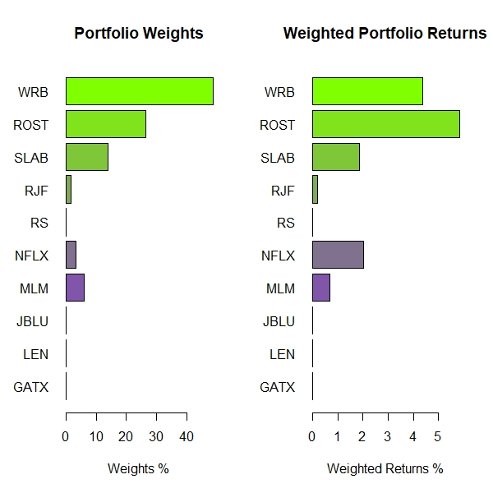
ANALYSIS AND RESULTS MID CAP
10 Stock Collection Analyzed
Long Only Strategy
Desired Return 15 pct
Covariance(Risk) Determined for Target Return
Portfolio Weights Determined
RESULTS
Best Performing Stocks – WRB, ROST, SLAB
NFLX Included Despite High Volatility

Slide 11
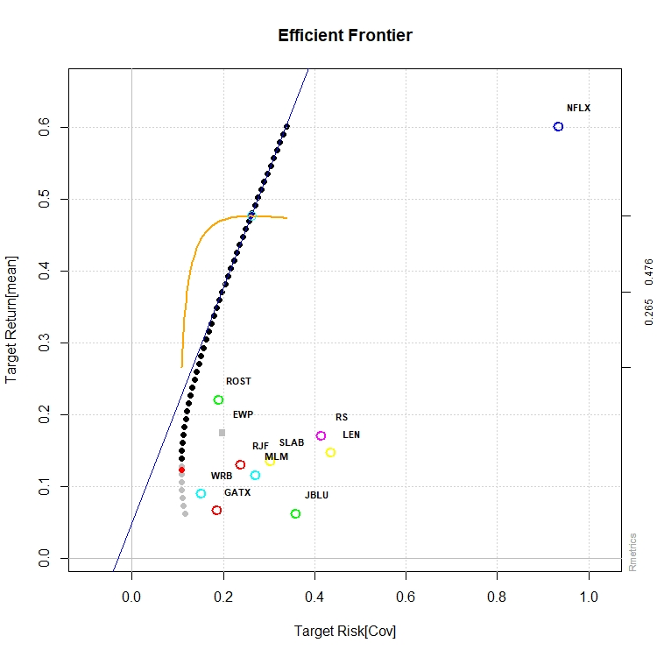
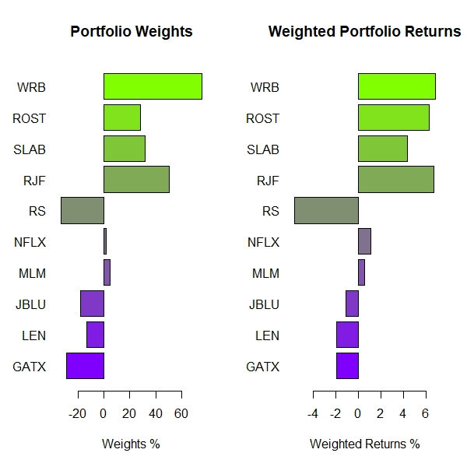
ANALYSIS AND RESULTS MID CAP
10 Stock Collection Analyzed
Long/Short Strategy
Desired Return 15 pct
Covariance(Risk) Determined for Target Return
Portfolio Weights Determined
RESULTS
Long Primarily on WRB, ROST, SLAB, RJF
Short on GATX, JBLU – Lower Performing Stocks

Slide 12
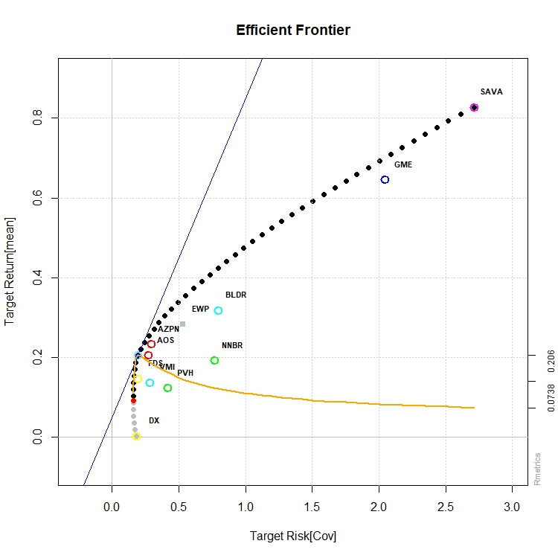
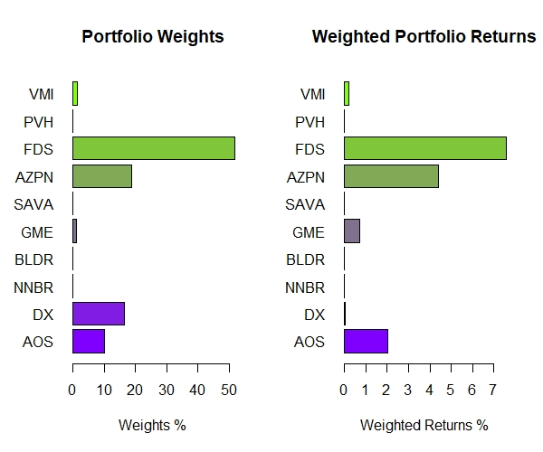
ANALYSIS AND RESULTS SMALL CAP
10 Stock Collection Analyzed
Long Only Strategy Evaluated
Desired Return 15 pct
Covariance(Risk) Determined for Target Return
Portfolio Weights Determined
RESULTS
Best Performing Stocks – FDS, AZPN, AOS

Slide 13
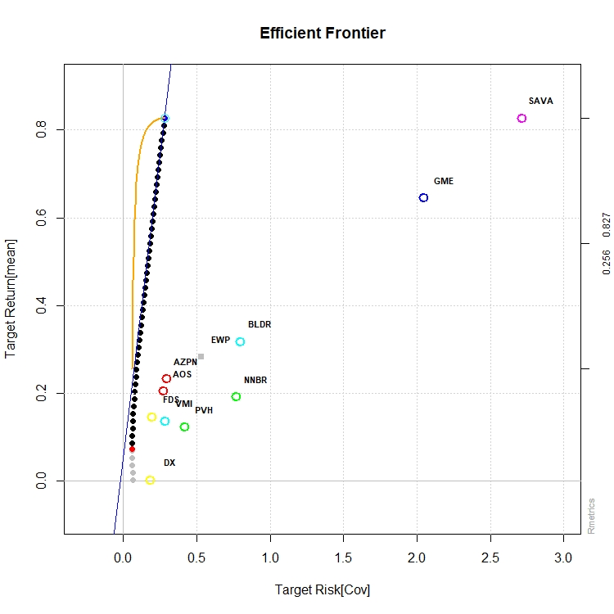
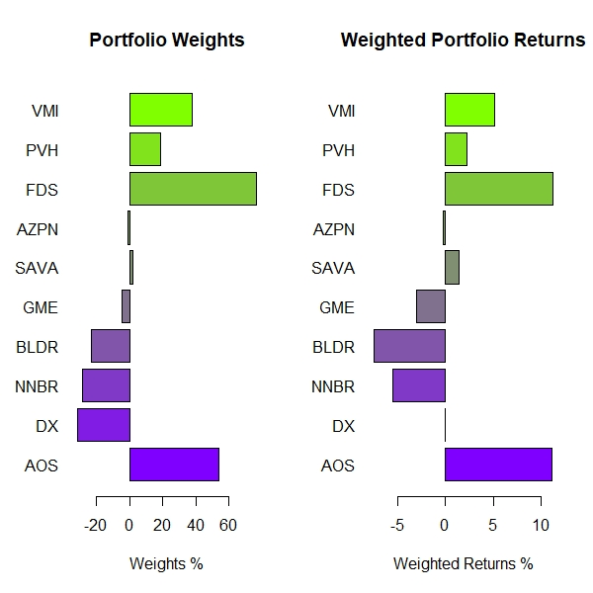
ANALYSIS AND RESULTS SMALL CAP
10 Stock Collection Analyzed
Long/Short Strategy
Desired Return 15 pct
Covariance(Risk) Determined for Target Return
Portfolio Weights Determined
RESULTS
Long Primarily on FDS and AOS
Short on BLDR and NNBR – Lower Performing Stocks and Higher Volatility

Slide 14
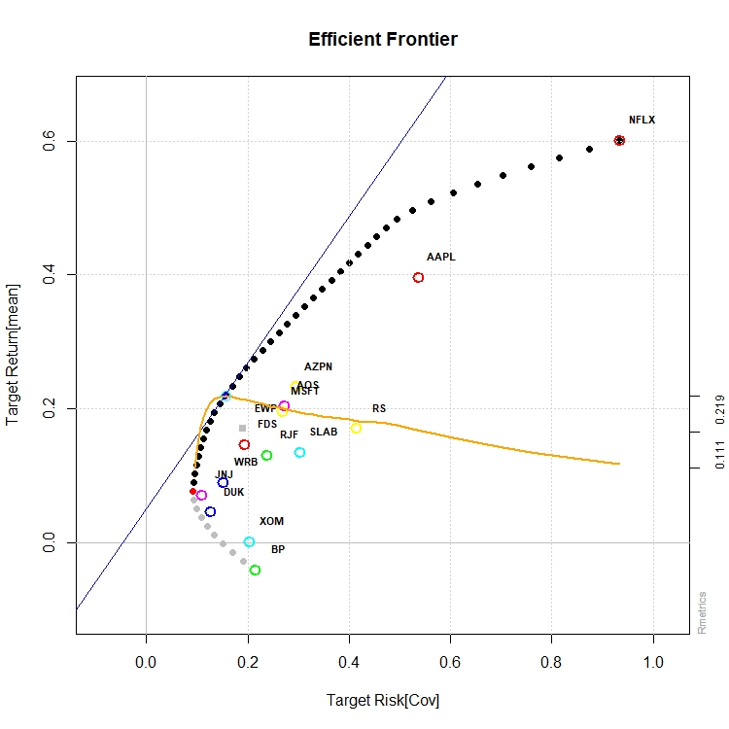
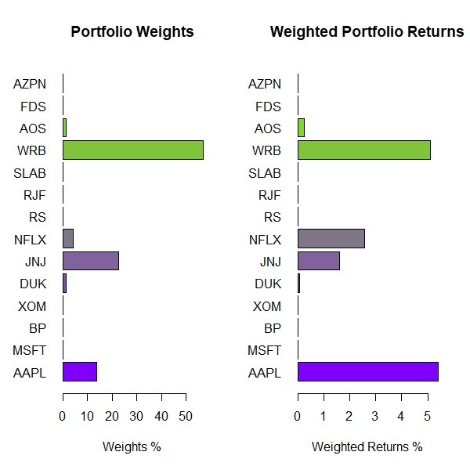
ANALYSIS AND RESULTS MIXED CAP
14 Stock Collection Analyzed
Long Only Strategy
Desired Return 15 pct
Best Performing from Previous Analysis
Lower Performing (BP) Included – Short Sell Potential
RESULTS
Best Performing Stocks – WRB, JNJ, AAPL
NFLX Included Despite Higher Volatility

Slide 15
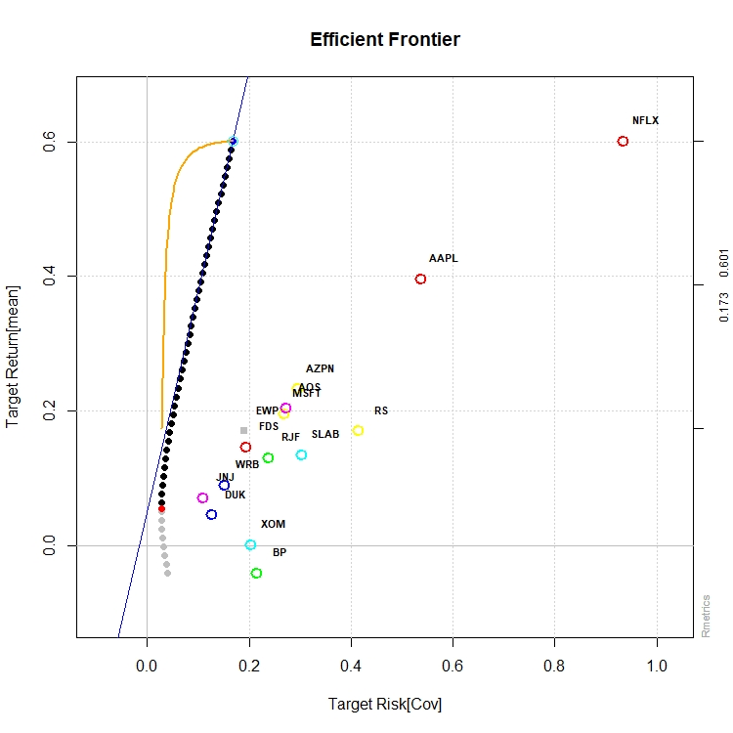
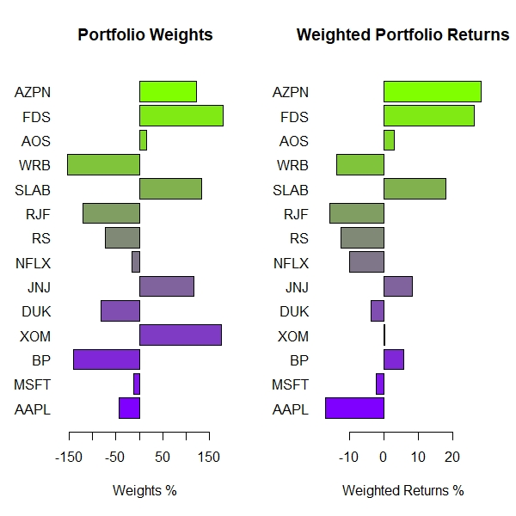
ANALYSIS AND RESULTS MIXED CAP
14 Stock Collection Analyzed
Desired Return 15 pct
Long/Short Strategy
Lower Performing (BP) Included – Short Sell Potential
RESULTS
Long Primarily on AZPN, FDS, SLAB, JNJ, and XOM
Short on BP, DUK, RS, WRB– Lower Performing Stocks, Higher Volatility Relative to Other Stocks

Slide 16
SHINY DASHBOARD
2 Apps Developed
App1 : Plots Efficient Portfolio for Portfolio Selected by User
Periodic Returns
App2: Prints Output with Portfolio Weights/Risk Budgets and Target Returns/Risk for Portfolio Selected by User

Slide 17
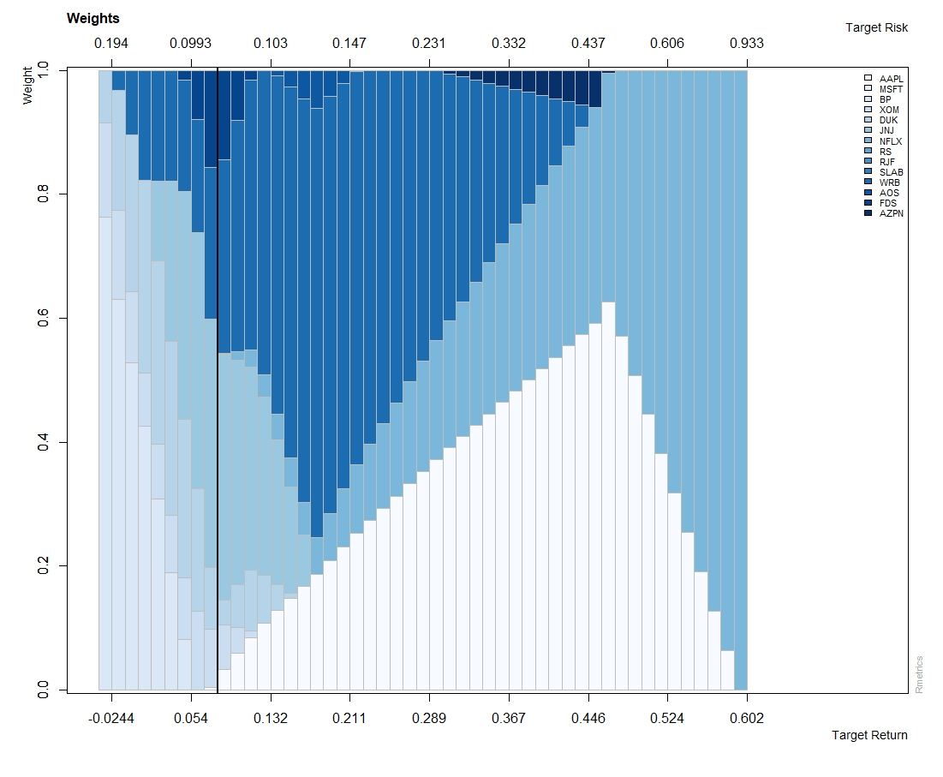
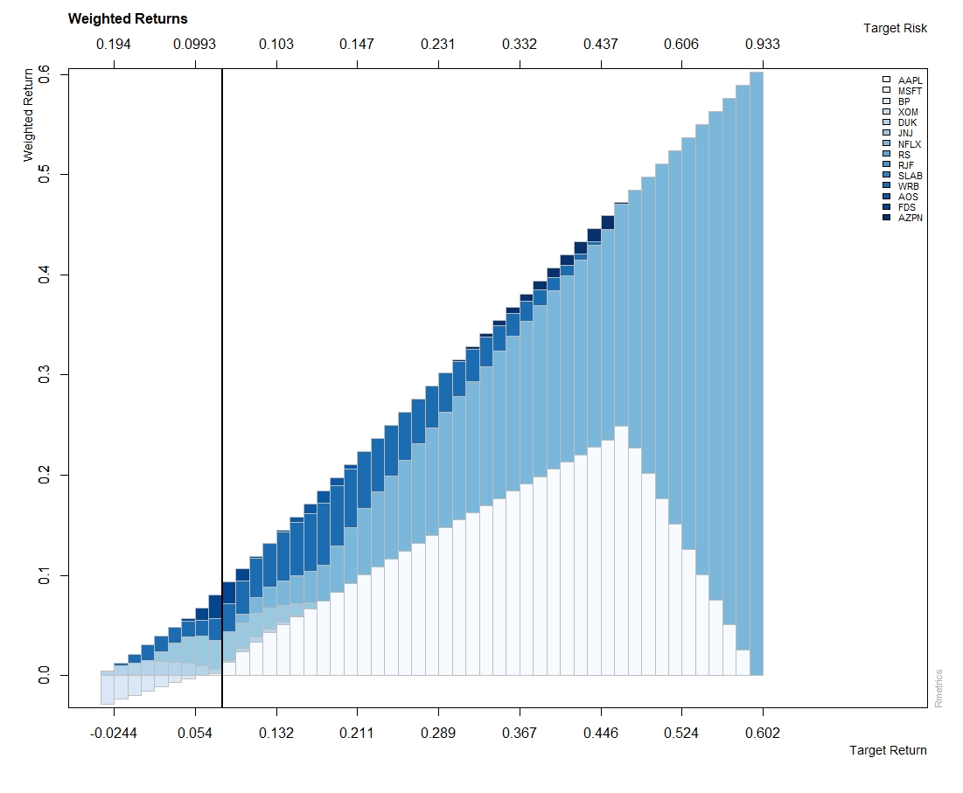
CONCLUSIONS
Asset Allocation Weights/Returns, Frontier Plot, Mixed Cap Long
R Packages – Robust Application for Stocks Analysis and Portfollio Selection
Diversified Portfolio Can be Selected using Markowitz’s Model
User Can:
Determine His/Her Risk Tolerance and Maximize Return Based on Individual Tolerance
Determine Risk for His/Her Desired Return
Allocation of Weights for Large, Mid, and Small Cap Developed
Mixed Cap Portfolio Developed Using Best Performing Stocks from Individual Analysis – Lowest Covariance (Risk) Obtained for this Portfolio Amongst All Portfolios Analyzed

